Slide 1
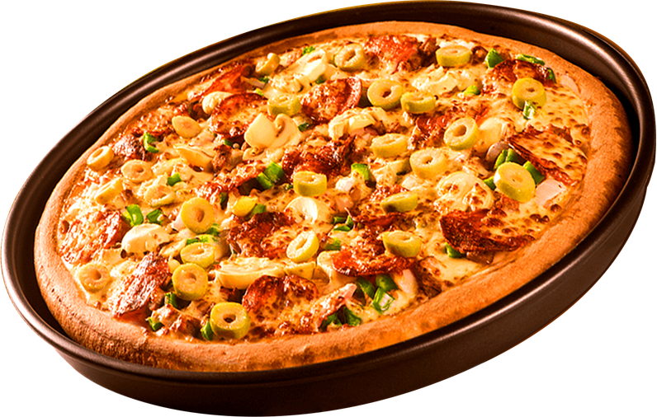
DATA ANALYTICS PROJECT
Pizza Sales
Analysis
SQL Data Analysis Project
Presented By: Vaishnavi Badhe
Data Analyst Project

Slide 2

Introduction
Hello! I am Vaishnavi Badhe. The Pizza Sales Analysis is a data analytics project that focuses on analyzing pizza sales data using SQL.
The main objective of this project is to understand sales performance, customer preferences, popular pizza categories, and revenue trends.
In this project, I used SQL queries to extract, analyze, and interpret meaningful insights from the pizza sales dataset.

Slide 3
Project Objectives
Pizza Sales Analysis – SQL Project · Basic Sales Analysis
Basic Sales Analysis
Pizza & Category Analysis
Q1. Retrieve the total number of orders placed.
Q2. Calculate the total revenue generated from pizza sales.
Q3. Identify the highest-priced pizza.
Q4. Identify the most common pizza size ordered.
Q5. List the top 5 most ordered pizza types along with their quantities.
Q6. Join the necessary tables to find the total quantity of each pizza category ordered.
Q7. Join the relevant tables to find the category-wise distribution of pizzas.
Order & Time Analysis
Revenue Analysis
Q8. Determine the distribution of orders by hour of the day.
Q9. Group the orders by date and calculate the average number of pizzas ordered per day.
Q10. Determine the top 3 most ordered pizza types based on revenue.
Q11. Calculate the percentage contribution of each pizza type to total revenue.
Q12. Analyze the cumulative revenue generated over time.
Q13. Determine the top 3 most ordered pizza types based on revenue for each pizza category.

Slide 4

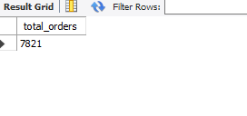
Q1
Retrieve the total number of orders placed.
SQL QUERY
RESULTS

Slide 5
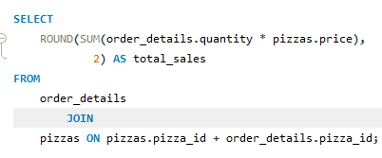

Q2
Calculate the total revenue generated from pizza sales.
SQL QUERY
RESULTS

Slide 6

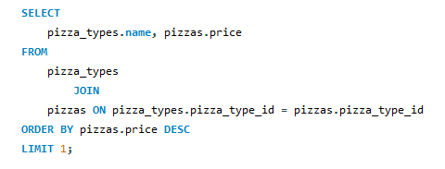
Q3
Identify the highest-priced pizza.
SQL QUERY
RESULTS

Slide 7
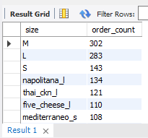
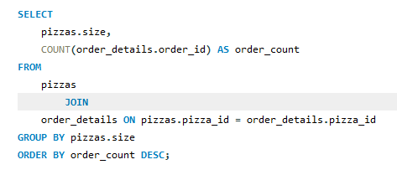
Q4
Identify the most common pizza size ordered.
SQL QUERY
RESULTS

Slide 8
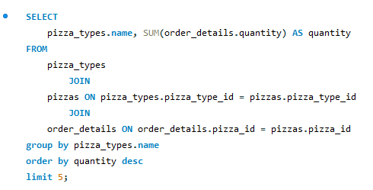
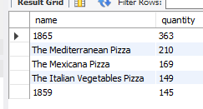
Q5
List the top 5 most ordered pizza types along with their quantities.
SQL QUERY
RESULTS

Slide 9
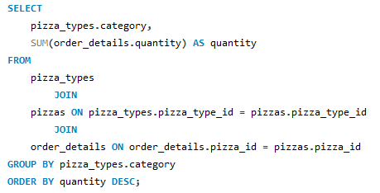
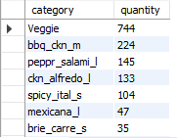
Q6
Join the necessary tables to find the total quantity of each pizza category ordered.
SQL QUERY
RESULTS

Slide 10
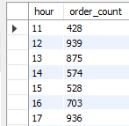
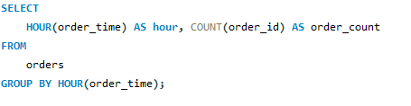
Q7
Determine the distribution of orders by hour of the day.
SQL QUERY
RESULTS

Slide 11
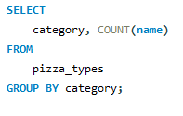
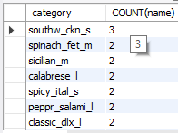
Q8
Join relevant tables to find the category-wise distribution of pizzas.
SQL QUERY
RESULTS

Slide 12
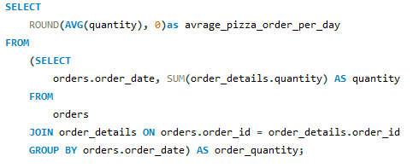

Q9
Group the orders by date and calculate the average number of pizzas ordered per day.
SQL QUERY
RESULTS

Slide 13
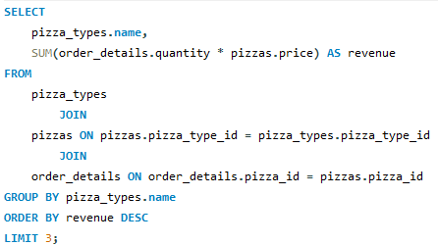

Q10
Determine the top 3 most ordered pizza types based on revenue.
SQL QUERY
RESULTS

Slide 14
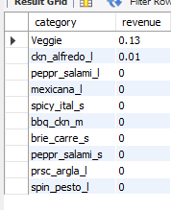
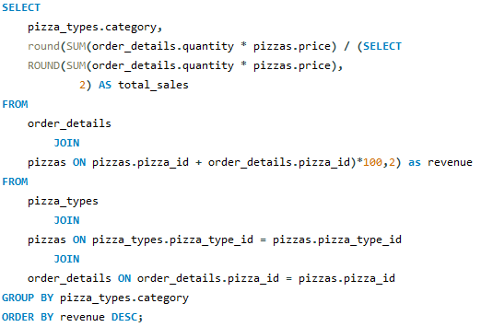
Q11
Calculate the percentage contribution of each pizza type to total revenue.
SQL QUERY
RESULTS

Slide 15
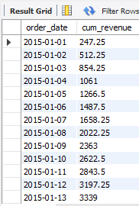
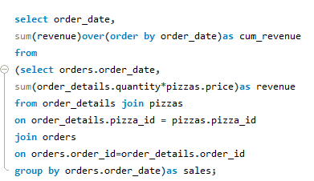
Q12
Analyze the cumulative revenue generated over time.
SQL QUERY
RESULTS

Slide 16
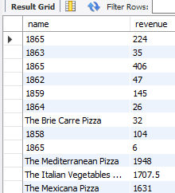
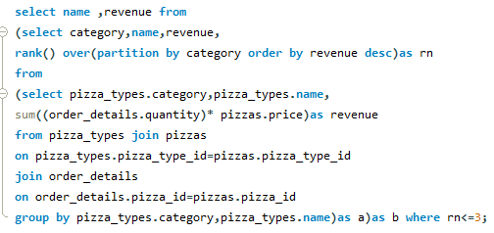
Q13
Determine the top 3 most ordered pizza types based on revenue for each pizza category.
SQL QUERY
RESULTS

Slide 17
Conclusion
In this Pizza Sales Analysis project, I successfully analyzed pizza sales data using SQL. I performed various SQL queries to identify total orders, total revenue, best-selling pizzas, popular pizza sizes, category-wise sales, and revenue trends.
Through this project, I gained practical knowledge of SQL concepts such as JOIN, GROUP BY, ORDER BY, aggregate functions, and window functions.
This analysis helped me understand sales performance and generate meaningful business insights that can support better business decisions. Overall, this project enhanced my SQL and Data Analysis skills.
JOIN
Multi-table queries
GROUP BY
Aggregated insights
ORDER BY
Ranked results
Window Functions
Cumulative revenue

Slide 18
Thank You
Questions & Answers
Pizza Sales Analysis · Presented By: Vaishnavi Badhe

